Slide 1
3D Probe Ptychography
Algorithm and preliminary results
Anders F. Pedersen
19-09-2018

Slide 2
Setup
Focused beam (probe): P_{j}
Detector (far field)
Slit in image plane: S
Sample: ρ
Optical axis
2θ
y
x
Objective lens: Aperture: Ap Aberrations: Ab
z

Slide 3
Parameters: Based on 3DBPP
Probe
2D Gaussian (symmetric)
Uniform phase (i.e. probe is real)
Rastered in 2D, perpendicular to the beam direction
Sample
Complex density
Phase inspired from edge dislocation wall
Fixed at central Bragg angle
2θ=56°(Al(333))
E=17keV
Objective lens
CRL, N=70, fN=26.5cm
Magnification, M=2
Aperture and aberrations are separated
Aperture is real 2D symmetric Gaussian
Aberration is complex with magnitude 1 and variable phase
Slit
Slit is placed in the image plane
Slit function is 1 inside slit and 0 outside
Slit is uniform along x
Slit is scanned up and down along y

Slide 4
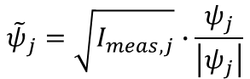
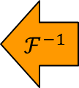
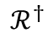
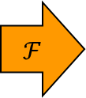
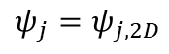


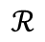
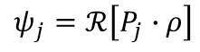
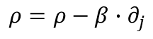
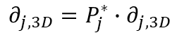
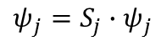
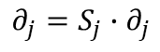

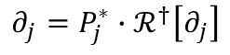
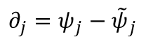
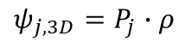
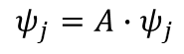

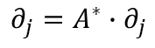
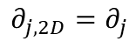
Algorithm: Based on 3DBPP
Sample plane
Objective plane
Image plane
Detector plane
$$ℱ$$
$$ℱ$$
$$ℱ$$
$${\tilde{ψ}}_{j}=\sqrt{I_{meas,j}}∙\frac{ψ_{j}}{\left|ψ_{j}\right|}$$
$$ψ_{j}=ℛ\left[P_{j}∙ρ\right]$$
$$ψ_{j}=A∙ψ_{j}$$
$$ψ_{j}=S_{j}∙ψ_{j}$$
$$ℱ^{−1}$$
$$ℱ^{−1}$$
$$ℱ^{−1}$$
$$∂_{j}=P_{j}^{∗}∙ℛ^{†}\left[∂_{j}\right]$$
$$∂_{j}=A^{∗}∙∂_{j}$$
$$∂_{j}=S_{j}∙∂_{j}$$
$$∂_{j}=ψ_{j}−{\tilde{ψ}}_{j}$$
$$ψ_{j,3D}=P_{j}∙ρ$$
$$ℛ$$
$$ψ_{j}=ψ_{j,2D}$$
$$ρ=ρ−β∙∂_{j}$$
$$∂_{j,3D}=P_{j}^{∗}∙∂_{j,3D}$$
$$ℛ^{†}$$
$$∂_{j,2D}=∂_{j}$$

Slide 5
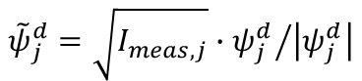
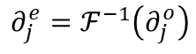
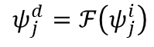
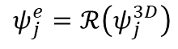
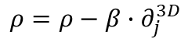
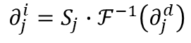
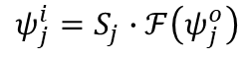
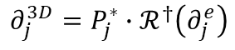
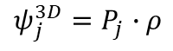
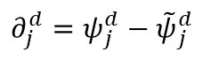
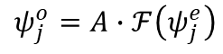
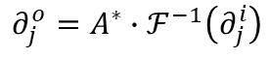
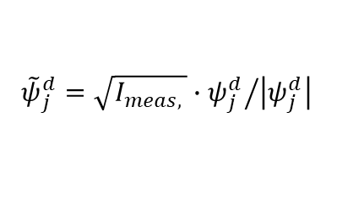
Algorithm: Based on 3DBPP
Sample plane
Objective plane
Image plane
Detector plane
$$ψ_{j}^{3D}=P_{j}∙ρ$$
$$ℱ$$
$$ℱ$$
$$ℱ$$
$$ψ_{j}^{d}=ℱ\left(ψ_{j}^{i}\right)$$
$$ψ_{j}^{o}=A∙ℱ\left(ψ_{j}^{e}\right)$$
$$ψ_{j}^{i}=S_{j}∙ℱ\left(ψ_{j}^{o}\right)$$
$$ψ_{j}^{e}=ℛ\left(ψ_{j}^{3D}\right)$$
$${\tilde{ψ}}_{j}^{d}=\sqrt{I_{meas,j}}∙{ψ_{j}^{d}}/{\left|ψ_{j}^{d}\right|}$$
$$∂_{j}^{e}=ℱ^{−1}\left(∂_{j}^{o}\right)$$
$$ℱ^{−1}$$
$$ℱ^{−1}$$
$$ℱ^{−1}$$
$$∂_{j}^{o}=A^{∗}∙ℱ^{−1}\left(∂_{j}^{i}\right)$$
$$∂_{j}^{i}=S_{j}∙ℱ^{−1}\left(∂_{j}^{d}\right)$$
$$∂_{j}^{3D}=P_{j}^{∗}∙ℛ^{†}\left(∂_{j}^{e}\right)$$
$$∂_{j}^{d}=ψ_{j}^{d}−{\tilde{ψ}}_{j}^{d}$$
$${\tilde{ψ}}_{j}^{d}=\sqrt{I_{meas, }}∙{ψ_{j}^{d}}/{\left|ψ_{j}^{d}\right|}$$
$$ψ_{j,3D}=P_{j}∙ρ$$
$$ℛ$$
$$ψ_{j}=ψ_{j,2D}$$
$$ρ=ρ−β∙∂_{j}^{3D}$$
$$∂_{j,3D}=P_{j}^{∗}∙∂_{j,3D}$$
$$ℛ^{†}$$
$$∂_{j,2D}=∂_{j}$$

Slide 6
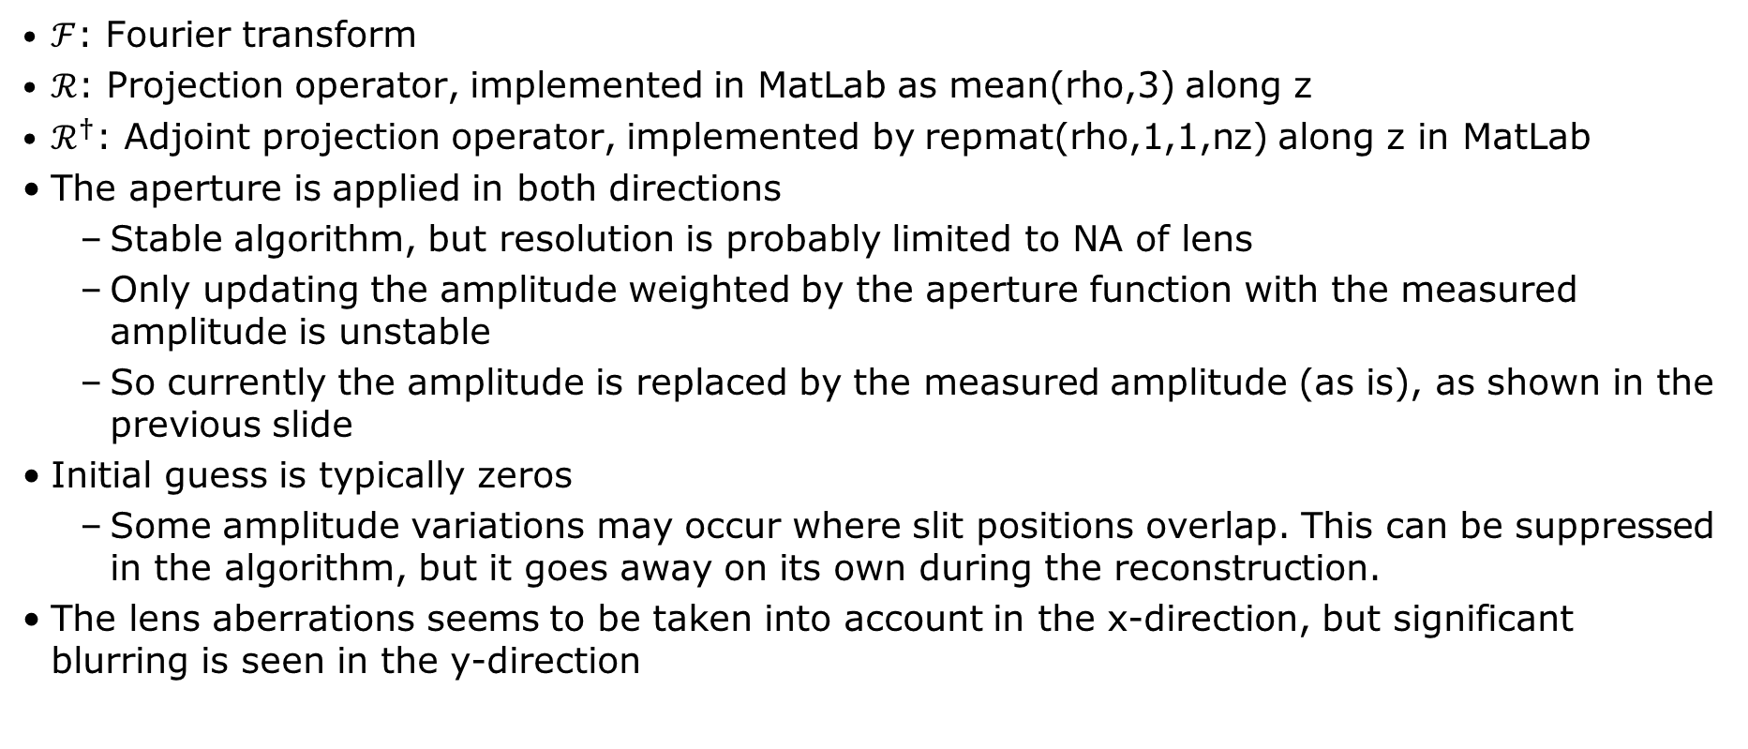
Notes on the algorithm
$ℱ$: Fourier transform
$ℛ$: Projection operator, implemented in MatLab as mean(rho,3) along z
$ℛ^{†}$: Adjoint projection operator, implemented by repmat(rho,1,1,nz) along z in MatLab
The aperture is applied in both directions
Stable algorithm, but resolution is probably limited to NA of lens
Only updating the amplitude weighted by the aperture function with the measured amplitude is unstable
So currently the amplitude is replaced by the measured amplitude (as is), as shown in the previous slide
Initial guess is typically zeros
Some amplitude variations may occur where slit positions overlap. This can be suppressed in the algorithm, but it goes away on its own during the reconstruction.
The lens aberrations seems to be taken into account in the x-direction, but significant blurring is seen in the y-direction

Slide 7
Reconstruction test
The object
3.5 um wide
Phase from edge dislocation wall, dislocations space 208 nm apart
Dislocation wall tilts two halves by 0.079°
The beam
Width of 195 nm (rms)
Steps in 2D square grid of 263 nm step size (64% overlap)
The objective
CRL, N=70, R=50 um, T=1.6 mm
d₁=42 cm, d₂=93 cm, d₃=3 m
σ_{a}=209 urad (rms), M=2.08
The slit
Opening 1.3 um (effective 625 nm)
Step size 866 nm (effective 417 nm)
Datapoints
Around 1800-1900

Slide 8
Reconstruction test
Testing 4 different setups
Lens aberrations, object phase
Lens aberrations, no phase in object
No aberration, object phase
No aberration, no phase in object
This allows us to separate artifacts from the phase features, from the perfect reconstruction, and from lens aberrations

Slide 9
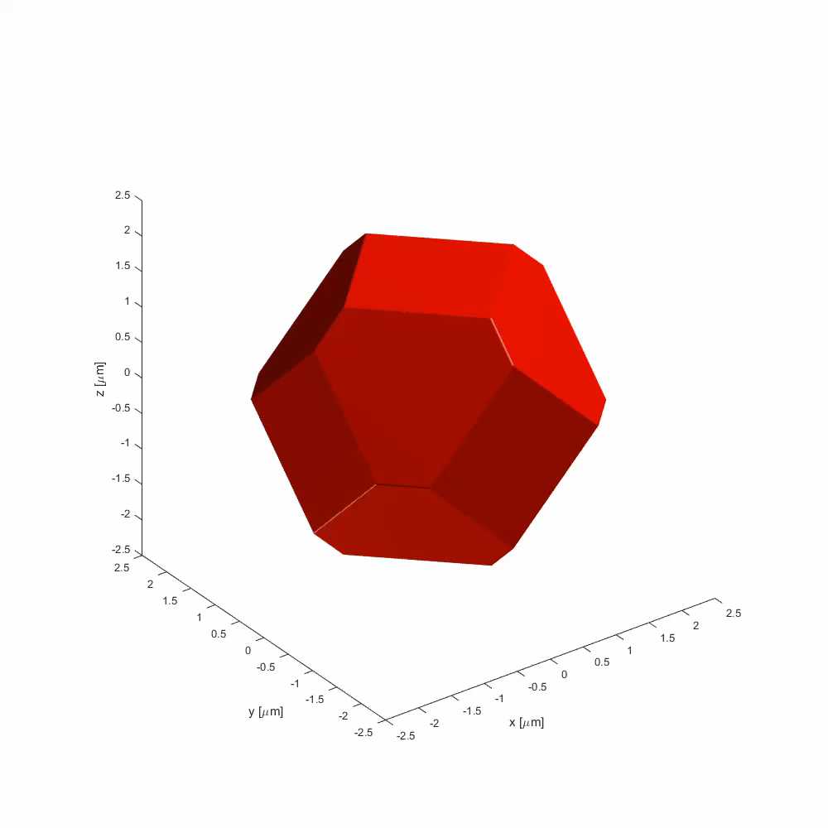
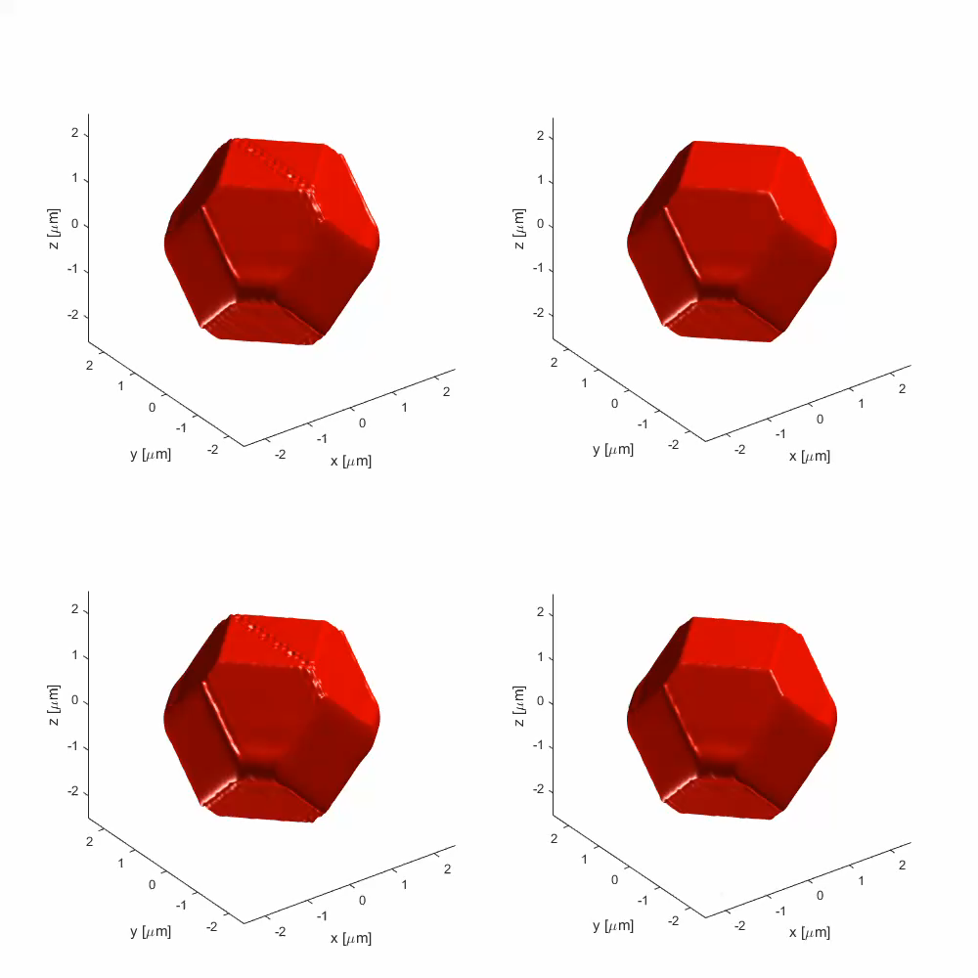
Sample shape at 50% amplitude
True object
Lens aberrations Dislocation phase
Lens aber. No phase
No aberrations Dislocation phase
No aber. No phase

Slide 10
True object (phase only for dislocation phase)

Slide 11
Reconstruction: Lens aber. + disloc. phase

Slide 12
Reconstruction: Lens aber. + no phase

Slide 13
Reconstruction: No aber. + disloc. phase

Slide 14
Reconstruction: No aber. + no phase

Slide 15
Test: projection + probe without ptychography

Slide 16
Strain in object
Negative strain
Positive strain

Slide 17
Resolution analysis
X-direction
30-40 nm (rms)
Independent of aberrations
Y-direction
20-30 nm (rms)
Independent of aberrations
Z-direction
175 nm (rms)
Independent of aberrations
Limited by beam size
Diagonal (semi-parallel to beam)
100-105 nm (rms)
Independent of aberrations
Diagonal (semi-perpendicular to beam)
100-105 nm (rms)
Independent of aberrations
Both diagonals limited by beam size

Slide 18
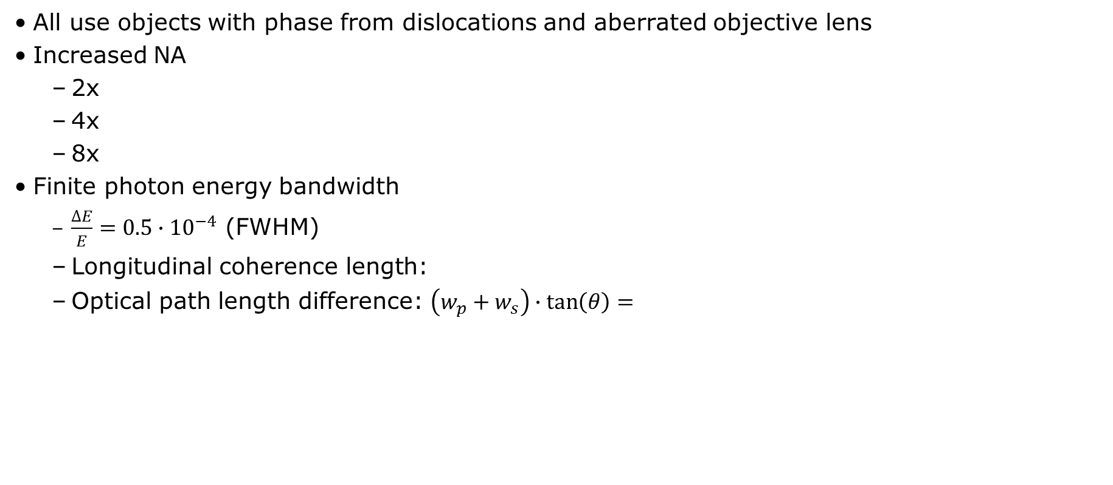
Additional tests
All use objects with phase from dislocations and aberrated objective lens
Increased NA
2x
4x
8x
Finite photon energy bandwidth
$\frac{∆E}{E}=0.5∙{10}^{−4}$ (FWHM)
Longitudinal coherence length:
Optical path length difference: $\left(w_{p}+w_{s}\right)∙\tan\left(θ\right)=$

Slide 19
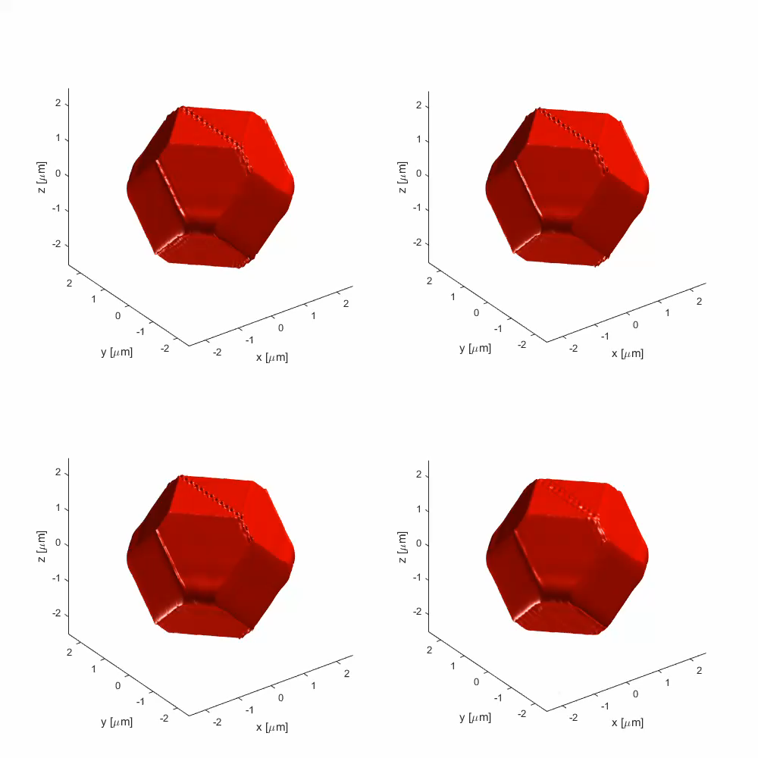
Additional tests: 3D renderings
NA – 2x
NA – 4x
NA – 8x
Partial coherence

Slide 20
NA – 2x

Slide 21
NA – 4x

Slide 22
NA – 8x

Slide 23
Partial coherence

Slide 24
Resolution analysis
X-direction
35 nm
NA does not influence resolution
Y-direction
NA 2x: 23 nm (rms)
NA 4x and 8x: 9 nm (rms)
Pixel size: 19.5 nm
Partial coherence: 26 nm
Z-direction
175 nm (rms)
Still limited by beam size

